Slide 1

WEB SCRAPPING
USING
3.8
VISHESH VISHWAKRMA
1836110059
ZAIN ABBAS
1836110061
CSE 4th YEAR

Slide 2
WHAT IS WEB SCRAPING ?
Web scraping, web harvesting, or web data extraction is data scraping used for extracting data from websites

Slide 3
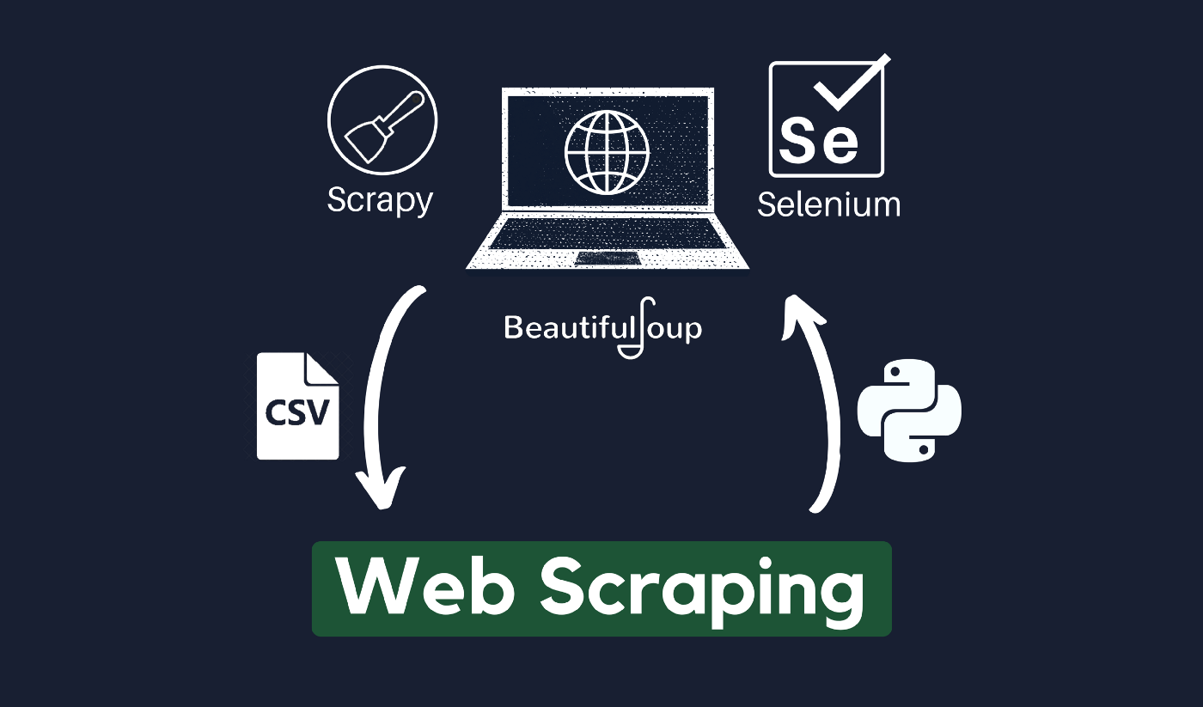
HOW DATA IS EXTRACTED FROM WEBSITES ?

Slide 4
TOOL USED FOR DATA SCRAPING IN PYTHON
Python offers a variety of libraries that one can use to scrape the web, libraires such as
BEAUTIFUL SOUP
SELENIUM
SCRAPY
URL LIB
REQUESTS

Slide 5
WHAT IS BEAUTIFUL SOUP ?
Beautiful Soup is a Python library that is used for web scraping purposes to pull the data out of HTML and XML files. It creates a parse tree from page source code that can be used to extract data in a hierarchical and more readable manner.

Slide 6

TOOL USED
JUPYTER NOTEBOOK
jupyterLab is a web-based interactive development environment for jupyter notebooks, code, and data.

Slide 7
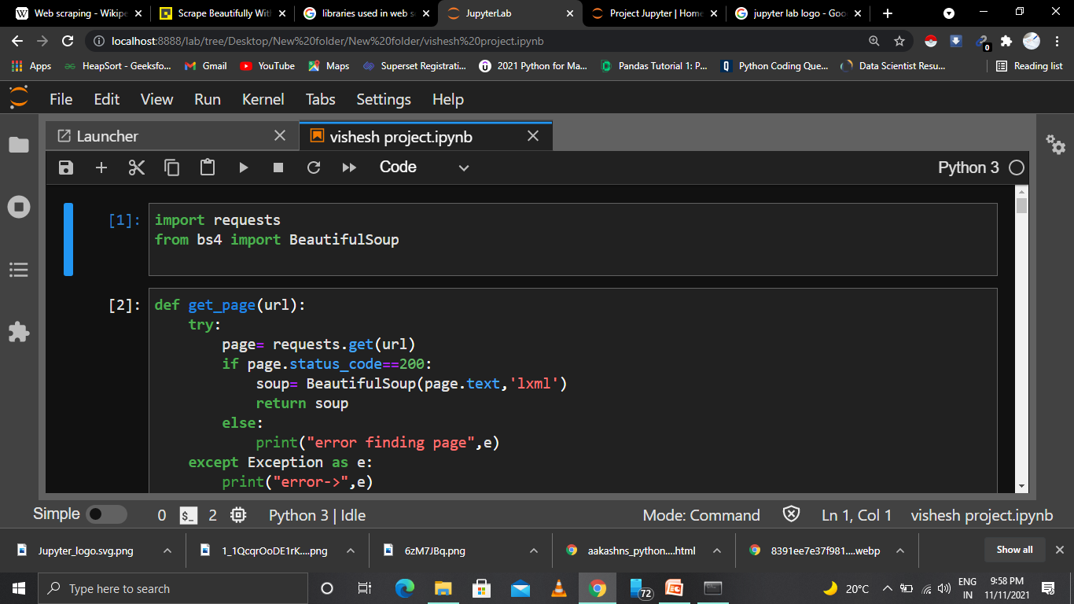
CODE EXAMPLE

Slide 8
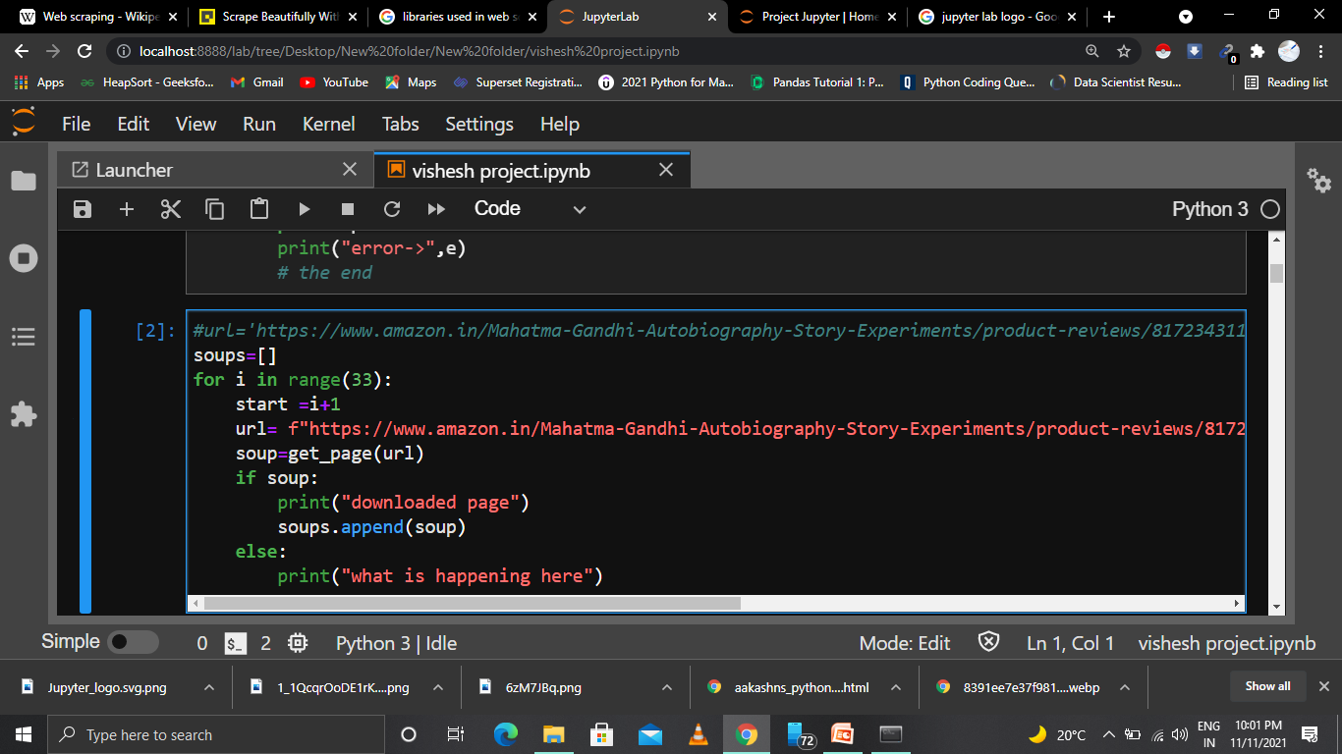
Web scraping of Amazon Website Product

Slide 9
EXTRACTED DATSET
EXTRACTED DATA IS IN ANY FORM .csv, .XML, .XLSX etc
CSV (Comma seperated value) A comma-separated values (CSV) file is a delimited text file that uses a comma to separate values. Each line of the file is a data record
An XLSX file is an Excel spreadsheet created by Microsoft Excel
It stores data in worksheets, which contain cells arranged in a grid of rows and columns

Slide 10
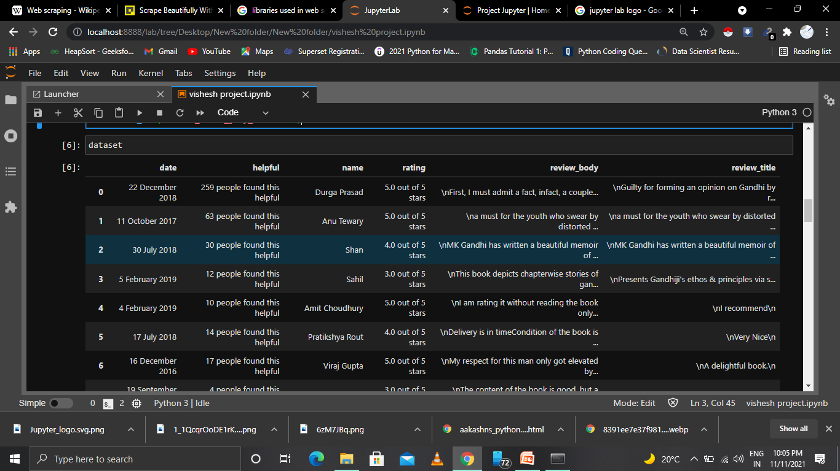
EXTRACTED DATA
EXTRACTED Data is in the form of row and column .

Slide 11
THANKYOU

